Slide 1
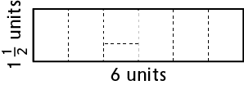
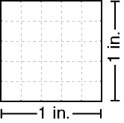
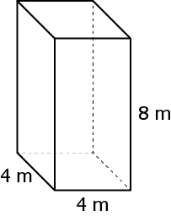
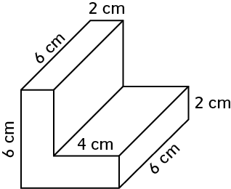
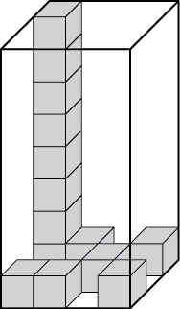
Everyday Math Chapter 1 Study Guide
1.Find the area of the rectangle.
5. 25 squares with a side length 1/5 inch fit in a 1 inch square.
How many squares with a side length 1/6 will fit into 1 square inch?
2.Solve:
a. 9 * (3 + 6) = __
b. (9 * 3) + 6 = __
c. __ = (42 ÷ 2) + 4
d. __ = 42 ÷ (2 + 4)
6.Find the volume of the rectangular prism. Remember to include a unit. Write a number sentence to show how you found the volume.
3. a. Julian filled a box and said its volume was 42 balls. Laura filled the same box and said its volume was 38 cubes. Explain how Julian and Laura cold get different volumes for the same box.
b. Are balls or cubes better for measuring the volume of a rectangular prism? Why?
7. Find the volume of this figure.
4. How many cubes would it take to fill the rectangular prism? What is the volume?
Vocabulary: 3-dimensional, area, braces, brackets, conjecture, cubic unit, expressions, grouping symbols, mathematical model, rectangular prism, square units, unit cube, unit squares, volume

Slide 2
Everyday Math Chapter 2 Study Guide
1.Solve the following number riddle.
I am a 5-digit number.
My 9 is worth 9 * 1,000.
My 4 is worth 40.
One of my 1s is worth 1.
The other 1 is worth 100 times as much.
My other digit is a 2.
What number am I? __
5. Write an expression with grouping symbols to model the number story.
Lydia is putting a small wire fence around her spice garden. The length around her garden is 5 inches short of 14 feet. What is the length around her spice garden in inches? Solve.
2. a. Aubrey collects paper for recycling. When she has 100 pounds, the recycling center will pick the paper up from her house. Aubrey has 25 boxes of paper that weigh about 5 pounds each. Should she call the recycling center to arrange a pick-up? Explain how you know.
b. Did you have to find an exact answer to solve Problem a? Explain why or why not.
6. Create a mathematical model for the problem. Then solve the problem and show your work.
Cora is selling homemade jam at the farmers’ market. She needs to figure out how many boxes to buy to transport the jam to the market. Each box holds 16 jars. She has 72 jars of jam. How many boxes should she buy?
Quotient:
Remainder:
What does the remainder represent?
3. a. Dhaval and Gavin were playing High-Number Toss. They created the numbers shown below. Write each player’s number in standard notation. Name the player who won the round.
Dhaval: 512 * 10⁵
Gavin: 544 * 10⁴
b. Explain how you wrote each number in standard notation.
7.Make an estimate and solve using US traditional multiplication.
216*8=
8.Make an estimate and solve.
345/8
Vocabulary: algorithm, area model, base, convert, dividend, divisor, estimate, expanded form, exponent, exponential notation, multiple, number model, partial products multiplication, partial quotient, partial-quotients division, place value, power of 10, quotient, remainder, standard notation
4. Write the number 491,036 in expanded form.

Slide 3
Everyday Math Chapter 3 Study Guide
1.Isaac has 6 gallons of flower nutrient for his garden. He plans to use the nutrients to feed his flowers for 30 days. If he wants to use the same amount of nutrients every day, how much of the nutrients should he use each day?
Solution:
Number model:
2. Three writers held a story contest. They received 278 entries. If all three writers wanted to judge an equal number of stories, how many stories should each writer judge?
Solution:
Number model:
Explain what you did with the remainder and why.
3. Write a division number story with an answer of 1/5.
4. Use division, the Fraction Number Lines, or fraction circle pieces to rename the fractions as mixed numbers.
24/7
27/4
5. Fill in the blanks:
___+ 1/3 > 1
2 ½- ___ < 1
6. A baker had 3 ½ pounds of flour. She used 4/5 of a pound to make a loaf of bread. How much flour does she have left?
Number model:
Estimate:
Answer:
7. Henry is training to run a mile faster than before. One month he ran a mile in 9 ¼ minutes. One month later he ran a mile in 8 2/4 minutes. Henry told his coach that he ran a mile 1 ¼ minutes faster in the second month.
What mistake did Henry make?
How much faster did Henry actually run a mile in the second month?
8. Solve:
1/8 + 2/24
3/6 + 1/18
1/5 of 25
1/7 of 21
1/3 of 10
Vocabulary: argument, benchmark, compare, denominator, dividend, divisor, equivalent fraction, fraction-of problem, interval, mixed number, model, numerator, quotient, representation

Slide 4
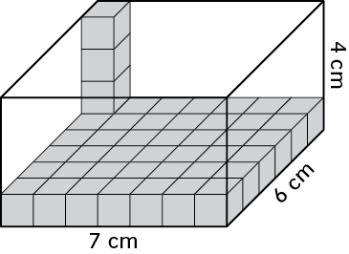
Everyday Math Chapter 4 Study Guide
1. Write the following expressions using numbers.
a. Subtract ninety-six from one hundred seventy-two and then multiply by four.
b. Subtract ninety-six from one hundred seventy-two and divide the difference by two.
c. Multiply the difference of one hundred seventy-two and ninety-six by five.
2. Write the following expressions in order from least to greatest.
(143-83)*4 (143-83)*2 (143-83)/3
Did you have to evaluate the expressions to order them? Explain.
3. a. Franklin is making a footpath in his garden with flagstones. He bought 97 flagstones at the store. He set aside 16 flagstones for another project. He placed 3 flagstones in each row of the footpath. Write an expression that models the number of rows in the footpath. Use grouping symbols in your expression.
b. Evaluate the expression to find the number of rows in Franklin’s footpath.
4. Dierdre said, “A brick does not have volume because you cannot fill it with unit cubes, and then count how many unit cubes are in the brick.”
Is Dierdre correct? Explain your answer.
5. The rectangular prism below is partially packed with centimeter cubes.
Find the volume of the prism.
Then describe three different strategies you could use to find the volume.
6. Make an estimate. Write a number sentence to show how you estimated. Use US traditional multiplication to solve.
512* 68=
65* 73=
7. Vanessa is packing lemons into sacks for sale at a farmers’ market.
She has 83 lemons to put into 15 sacks.
She wants to put the same number of lemons in every sack.
How many lemons should she put in each sack?
8. Carly has 2 cucumbers.
She is making 7 salads for a family dinner.
If she wants to put the same amount of cucumber in every salad, how much cucumber should she put in each salad?
9. Rewrite each power of 10 in exponential notation, then solve.
7*100= 7* 10__
18*100,000= 18* 10__
29*10,000,000= 29*10__
Vocabulary: addend, algorithm, column addition, coordinate grid, coordinates, decimal, decimal point, digit, expanded form, extrapolate, hundredths, interpolate, intersect, ordered pair, partial-sums addition, perpendicular, plot, rounding, tenths, thousandths, x-axis, x-coordinate, y-axis, y-coordinate

Slide 5
Everyday Math Chapter 5 Study Guide
1. Find a common denominator for the pairs of fractions given.
Rewrite the fractions as equivalent fractions with a common denominator.
a. 45 and 715
b. 23 and 34
2. Use equivalent fractions to solve.
4/5 – 7/15
2/3 + ¾
3. Estimate, then solve. Use your estimate to check whether your answer makes sense.
6 4/9 + 4 2/3
4. Estimate, the solve. Use your estimate to check whether your answer makes sense.
8 6/9 – 2 2/12
5. Jeff walked 3 3/5 miles on Wednesday and 2 2/5 miles on Thursday. How many miles did he walk on Wednesday and Thursday all together?
Number model:
Estimate:
Answer:
6. What is 2/8 of 32?
7. What is 5/8 of 32?
8. Solve.
15 * 2/3
9. Solve
36 * 2/9
10. Look at the problem 27* 5/9.
Will the product be greater than 27? How do you know?
Will the product be greater than 5/9?
Solve.
11. Use the paper folding method to solve 1/3 of ½. Draw lines in the rectangle to show what you did.
12. Write a number story that matches the expression 4/5 * 25. Then solve.
13. Use the fraction multiplication algorithm to solve.
2/8 * 4/5
Vocabulary: algorithm, area model, common denominator, dimensions, dividend, divisor, equivalent fraction, factor, factor pair, horizontal, multiple, Multiplicative Identity Property, product, quick common denominator, quotient, unit fraction, vertical

Slide 6
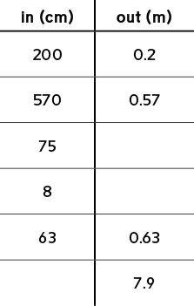
Everyday Math Chapter 6 Study Guide
1.9 * 10¹ =
2. 1.9 * 10² =
3. 1.9 * 10³ =
4. 16.5/ 10¹ =
5. 16.5/ 10² =
6. 16.5/ 10³ =
7. Convert between centimeters and meters to complete the “What’s My Rule” table. The write a rule using a power of 10 in exponential notation.
10. Solve.
18.2 * 5.9 =
61.4 * 58.8 =
11. Make an estimate, then divide as if the dividend were a whole number. Use your estimate to place the decimal point in your answer.
7.84/ 4 =
12. Write an equivalent problem that has a whole-number divisor. Then solve the equivalent problem and complete the number sentence.
3.5/ 0.7=
13. A rectangular one-story house covers an area of 1,800 square feet. The ceilings are 7 feet high. What is the volume of the interior of the house?
Number model:
The owners added a second floor to the house. The second floor is 40 feet long and 20 feet wide with ceilings that are 7 feet tall. What is the volume of the interior of the second floor?
Number model:
8. Alvaro is putting down flooring in his bathroom. He has a sheet of flooring that is 2.8 meters long. He cuts off 9 centimeters from the end to make it fit. How long is the piece of flooring Alvaro puts in his bathroom?
9. Use estimation to place the decimal point in each product.
61.2 * 5.3 = 3 2 4 3 6
3.14* 19.1= 5 9 9 7 4
Vocabulary: base, data point, data set, displacement method, equivalent problem, exponent, exponential notation, line plot, metric system, power of 10, scale

Slide 7
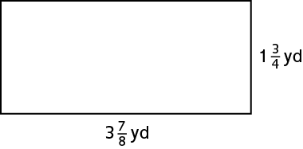
Everyday Math Chapter 7 Study Guide
Solve.
3* 4 5/9
2 ¾ * 5 8/9
2. Write a number story that can be modeled using 3 * 4 5/9
3. Dimitry’s class created a mural in the hallway. The space that they used for the mural is shown below. What is the area of the mural?
7. These numbers show how the average time Oliver’s friends spend brushing their teeth. Use the data to create a line plot.
What is the difference between the longest amount of time and the shortest amount of time his friends spend brushing their teeth?
How many friends brush their teeth for less than 2 minutes?
How much time do those friends spend brushing their teeth combined?
Vocabulary: attribute, common denominator, corresponding terms, cubit, equilateral triangle, hierarchy, great span, isosceles triangle, kite, parallel, parallelogram, partial products, polygon, quadrilateral, rectangle, rhombus, square, subcategory, trapezoid, unit fraction
4. Solve the problem using common denominators. Use multiplication to check your answer.
8/ ½ =x
1/7 / 2=x
5. List as many names for this figure as your can. You may use the Quadrilateral Hierarchy to help you solve the problem.
6. Jacob made 3 liters of soup. If one serving is ½ liter, how many servings does Jacob have?
Number model:

Slide 8
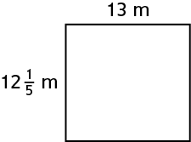
Everyday Math Chapter 8 Study Guide
1. A group of neighbors converted an old parking lot into a play area.
A model of the play area is shown below. Use the model to answer the question.
Remember to pay attention to the units when answering the question.
What is the perimeter of the playing surface in square meters?
The neighbors want to put a fence around the play area. They plan to buy chain-link fencing sold by the centimeter. How many centimeters of fencing should they buy to completely surround the play area? Explain how you know.
The neighbors want to paint the entire playing surface. What is the area of the playing surface in square meters?
How many square centimeters is that?
If each can of paint covers about 100 square meters, how many cans of paint should the neighbors buy?
Vocabulary: accounting, acre, budget, debt, unit conversion, unit cost, wages, pendulum
The neighbors shoveled snow off of the playing surface after a storm. How many cubic meters of snow did they remove?
2. A typical elephant’s heart beats about 30 times per minute.
a. How many times does a typical elephant’s heart beat in one hour?
About __ times
b. How many times does a typical elephant’s heart beat in one day?
About __ times
c. How many times does a typical elephant’s heart beat in one week?
About __ times
3. A hummingbird “flaps” its wings by rotating them back and forth. A small hummingbird can flap its wings about 80 times per second. About how many times does a small hummingbird flap its wings in one hour? Show your work. Hint: 1 hour = 3,600 seconds
4. Understand how to read data on a line plot to identify whether or not data is related.

